Slide 1

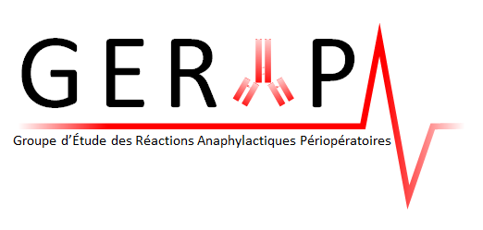
sensitization to NMBAs beyond pholcodine
Paul Michel Mertes
Professeur Emerite Université deStrasbourg – UMR INSERM u1255
paulmertes48@gmail.fr

Slide 2
Disclosure
Academical : GERAP, INSERM , ISPAR et ESA, ENDA, RAV, TRAM
Lecture : ALK, MSD, Aguettant
Adviser : Provepharm
ALPHO : Grant from the following pharmaceutical companies : Zambon, Urgo, Pierre Fabre, Boots, Hepatoum, Biocodex, Sanofi, LBR, GSK, APL, Bells Healthcare, Pinewood, T & R, Ernest Jackson

Slide 3
First case of Hypersensitivity to a NMBA
In 1949, Cecil and Lorrain Smith reported a case of immediate hypersensitivity to d-tubocurarine published in the BMJ.

Slide 4
Diagnosis of the causes of anaphylactoid anaesthetic reactionsA report of the recommendatiom of the joint Anaesthetic and Immuno-allergological Workshop, Nancy,France: 19 March 1982
skin tests using various concentrations of the drug(s),
human basophil degranulation test or leucocyte histamine release
Prausnitz-Kustner (PK) tests with both untreated and heated serum from the patient to demonstrate the presence of either specific IgE (heat labile) or IgG antibodies to the drug(s)
Laxenaire MC, Moneret-Vautrin DA, Watkins J. Diagnosis of the causes of anaphylactoid anaesthetic reactions. A report of the recommendations of the joint Anaesthetic and Immuno-allergological Workshop, Nancy, France: 19 March 1982. Anaesthesia. 1983 Feb;38(2):147-8.

Slide 5
NMBAs, allergy and immunological dogma

Slide 6
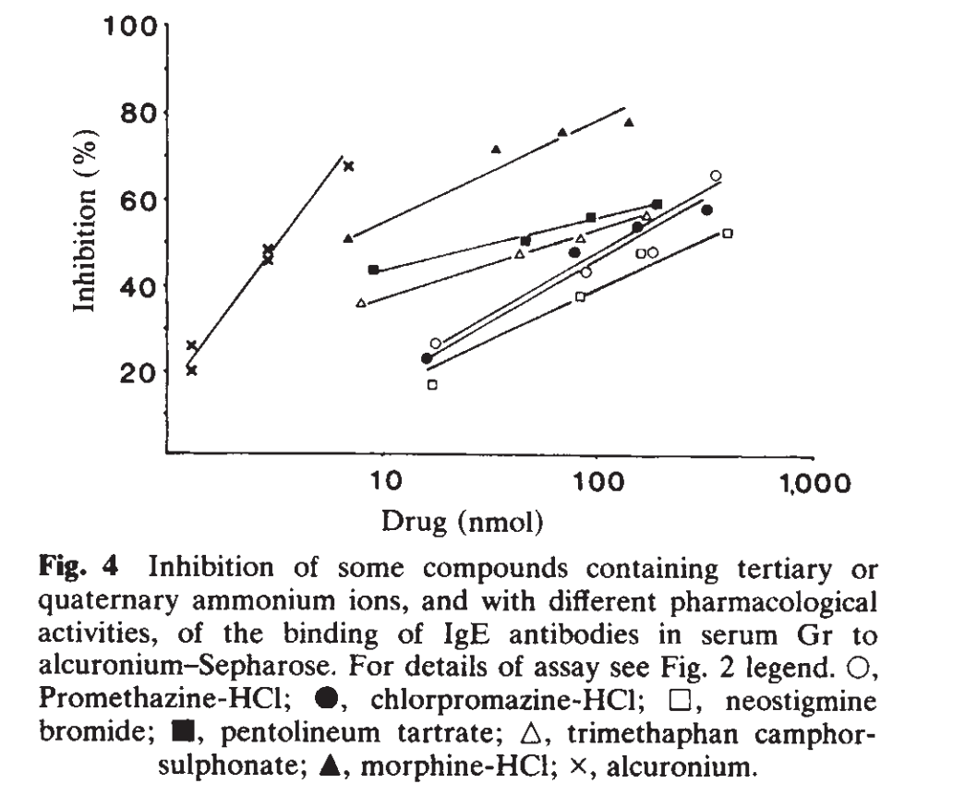

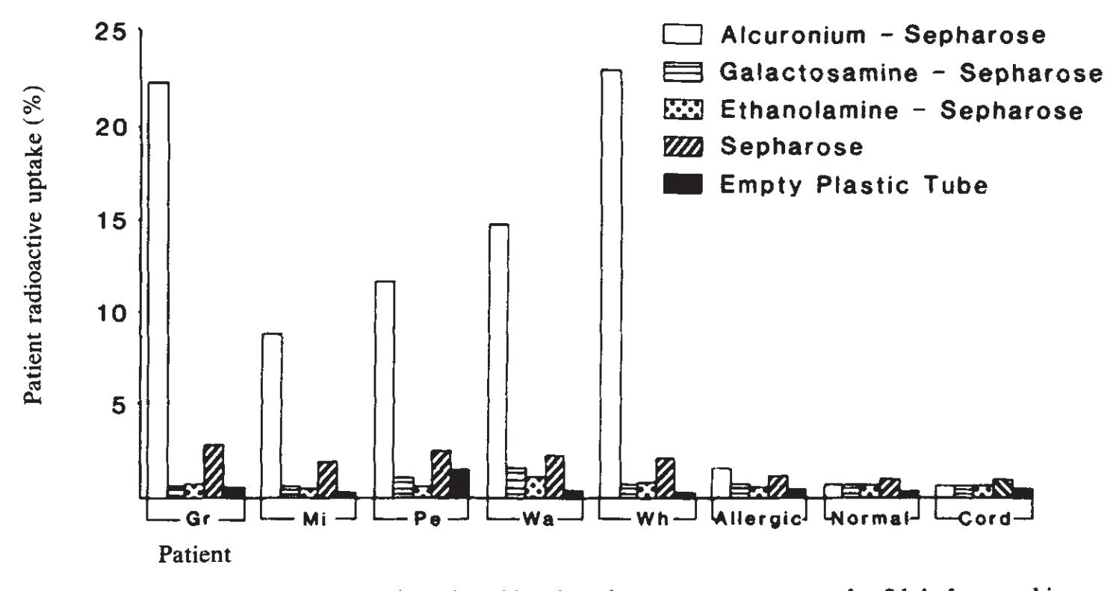
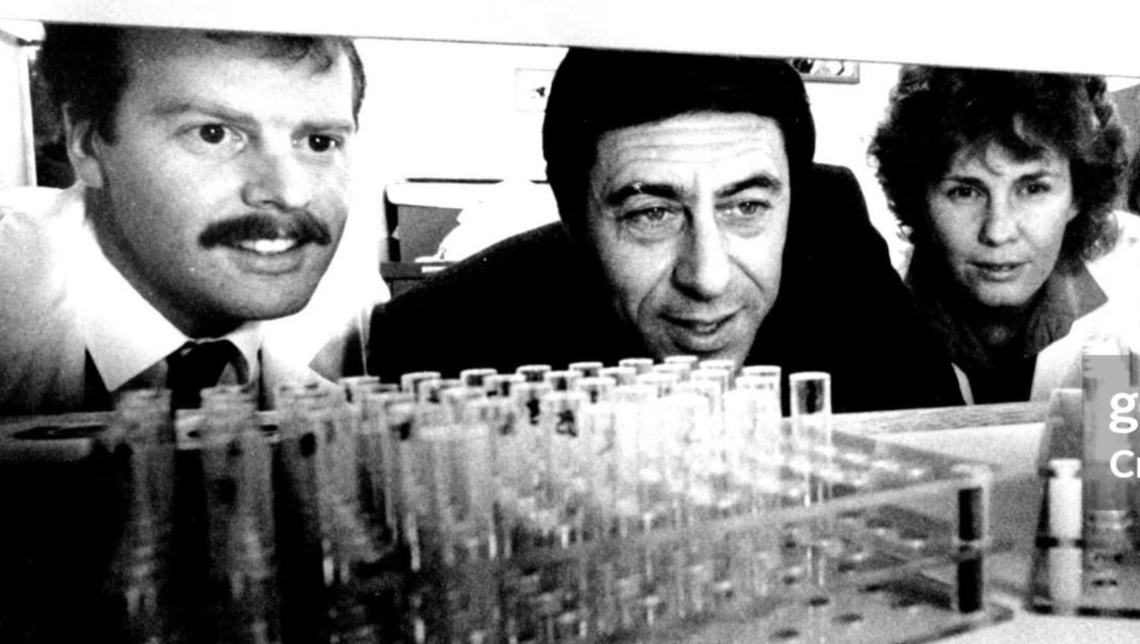
Substituted ammonium ions as allergenic determinants in drug allergy
Baldo BA, Fisher MM. Substituted ammonium ions as allergenic determinants in drug allergy. Nature. 1983 Nov 17-23;306(5940):262-4.

Slide 7
Substituted ammonium ions as allergenic determinants in drug allergy
… Alcuronium-reactive antibodies were found in five drug-sensitive subjects and most of the antibodies cross-reacted with other muscle relaxants and with a variety of apparently structurally unrelated drugs
… Structure-activity studies designed to explore the molecular basis of the antibody binding established that quaternary and tertiary ammonium ions were the complementary allergenic sites on the reactive drugs…
... Sensitivity might be established by prior exposure to substituted ammonium groups on a compound that is otherwise structurally unrelated to the NMBAs. Such compounds are many, widely distributed and often contacted in everyday activities.
Baldo, B A. Fisher, M M., Nature. 306(5940):262-4, 1983 Nov 17-23.

Slide 8
IgE-cross linking
Multivalent drug -- carrier complexes are said to be a requirement for cross-linking of mast cell-bound IgE .
NMBAs did not bind to plasma proteins
The substituted ammonium ions of NMBAs:
  are responsible for neuromuscular blocking and allergenic properties
  are at a distance from 1 to 1.45 nm
Divalency of NMBAs could explain allergen-induced mediator release in a sensitized subject even in the absence of protein binding.

Slide 9
Environmental agents
Compounds containing tertiary amine or quaternary ammonium groups occur widely in drugs, cosmetics, disinfectants, industrial materials, foods…
Only a small number of cases of anaphylaxis apparently provoked by environmental agents have been reported
The theory of environmental sensitization
remains unproven and difficult to establish.

Slide 10
Previous Exposure
IgE-mediated reactions after exposure to a drug are generally assumed to be due to the prior sensitization of the allergic subject by the drug
But : lack of previous exposure
  At least 17% in France
  Up to 75% in Australia
Sources : Mertes et al, Fisher et al

Slide 11
Results from skin-test investigations
Patients may react with :
  All NMBAs ➔ a single overwhelmingly dominant allergenic determinant structure quaternary ammonium determinant (alcuronium)
  A single NMBAs or Several NMBAS with or without class effect ➔ neighboring groups of different structures on the different NMBAs, in addition to the substituted ammonium groups, form part of the allergenic determinant structure
Baldo et al, Clin Exp Allergy 2009

Slide 12
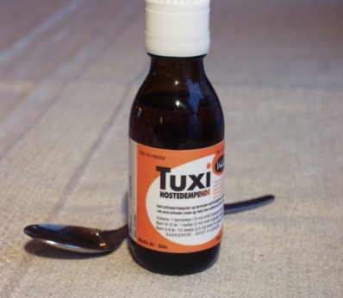

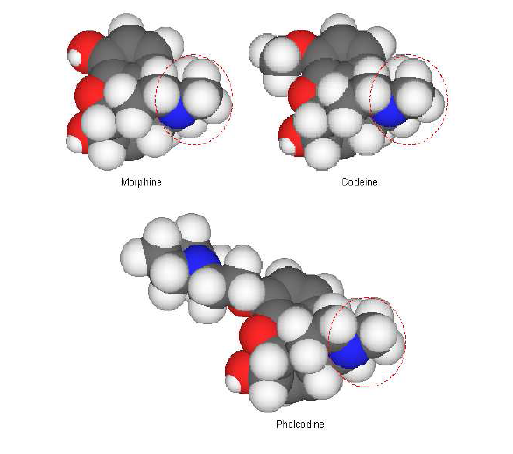
The Pholcodine hypothesis
The Cough Sirup Tuxi
Methyl-substituted tertiary amine group
Haukeland University Hospital &
University of Bergen,
Bergen, Norway

Slide 13
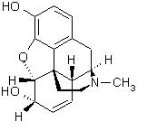
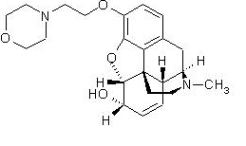
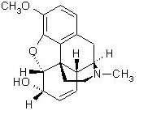
Morphiniques
Morphine
Groupement morpholinyl
Amine tertiaire
(cyclique)
Pholcodine
(BIOCALYPTOL® sirop
POLERY® sirop
RESPILENE® sirop…)
Amines tertiaires
(cycliques)
Codéine
Amine tertiaire
(cyclique)

Slide 14
_{Pholcodine Hypothesis}
a small molecule key that turns on polyclonal IgE synthesis
    by downregulating inhibitory mechanisms ?
leads to IgE sensitization in a considerable proportion of exposed individuals
has a striking effect on IgE synthesis in sensitized individuals
can explain the differences in prevalence of IgE-sensitization and frequencies of reported NMBA anaphylaxis between Norway and Sweden
    and possibly also for other countries?

Slide 15
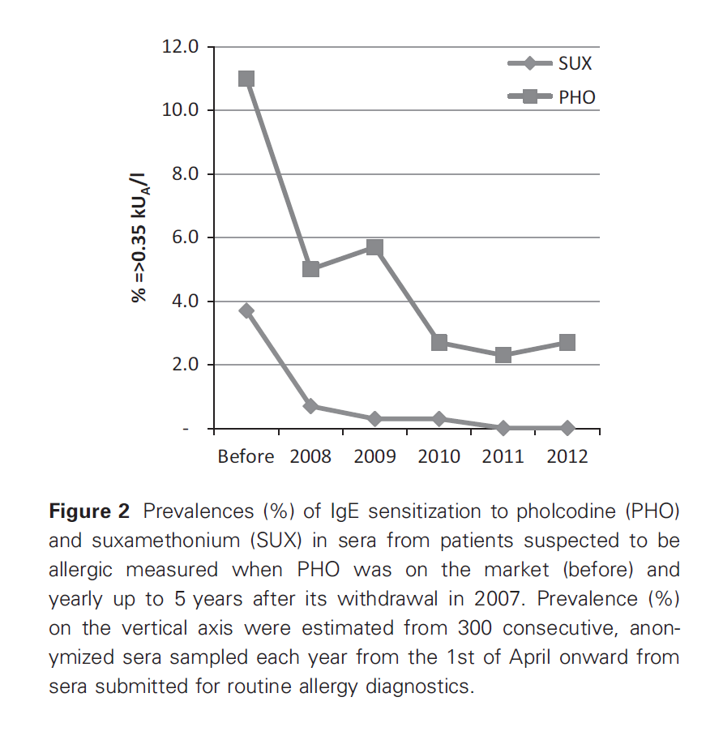
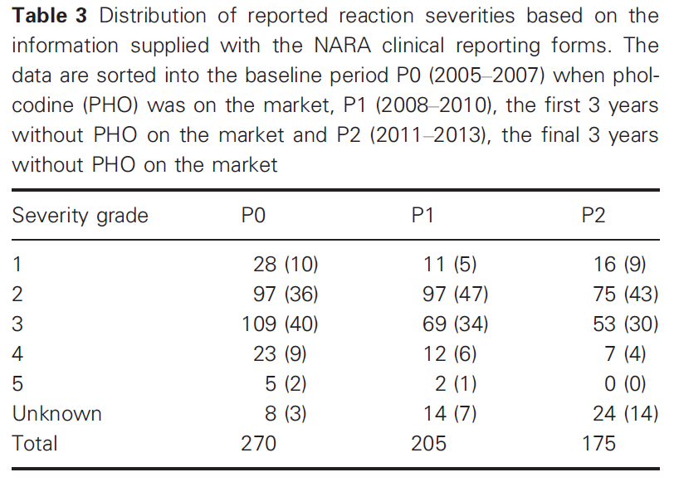
Six years without Pholcodine; Norwegians are significantly less IgE-sensitized and clinically more tolerant to neuromuscular blocking agents.
de Pater GH, Florvaag E, Johansson SG, Irgens Å, Petersen MN, Guttormsen AB. Allergy. 2017 May;72(5):813-819.

Slide 16

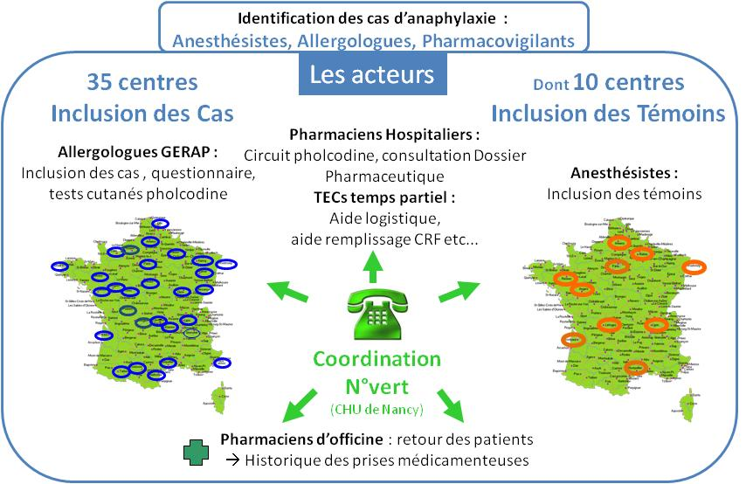
CFA 18/04/2013
16
Notes:
ALPHO
16

Slide 17
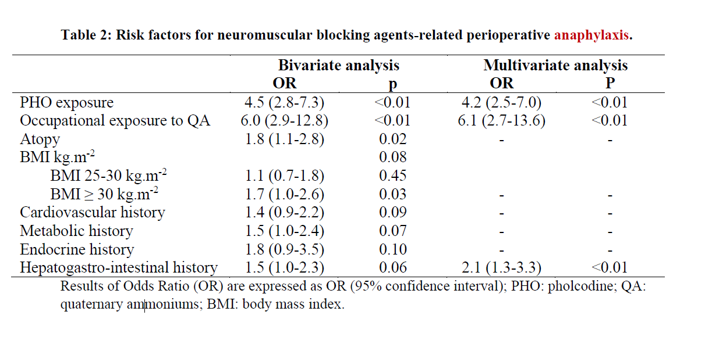
Mertes et al, BJA in press

Slide 18
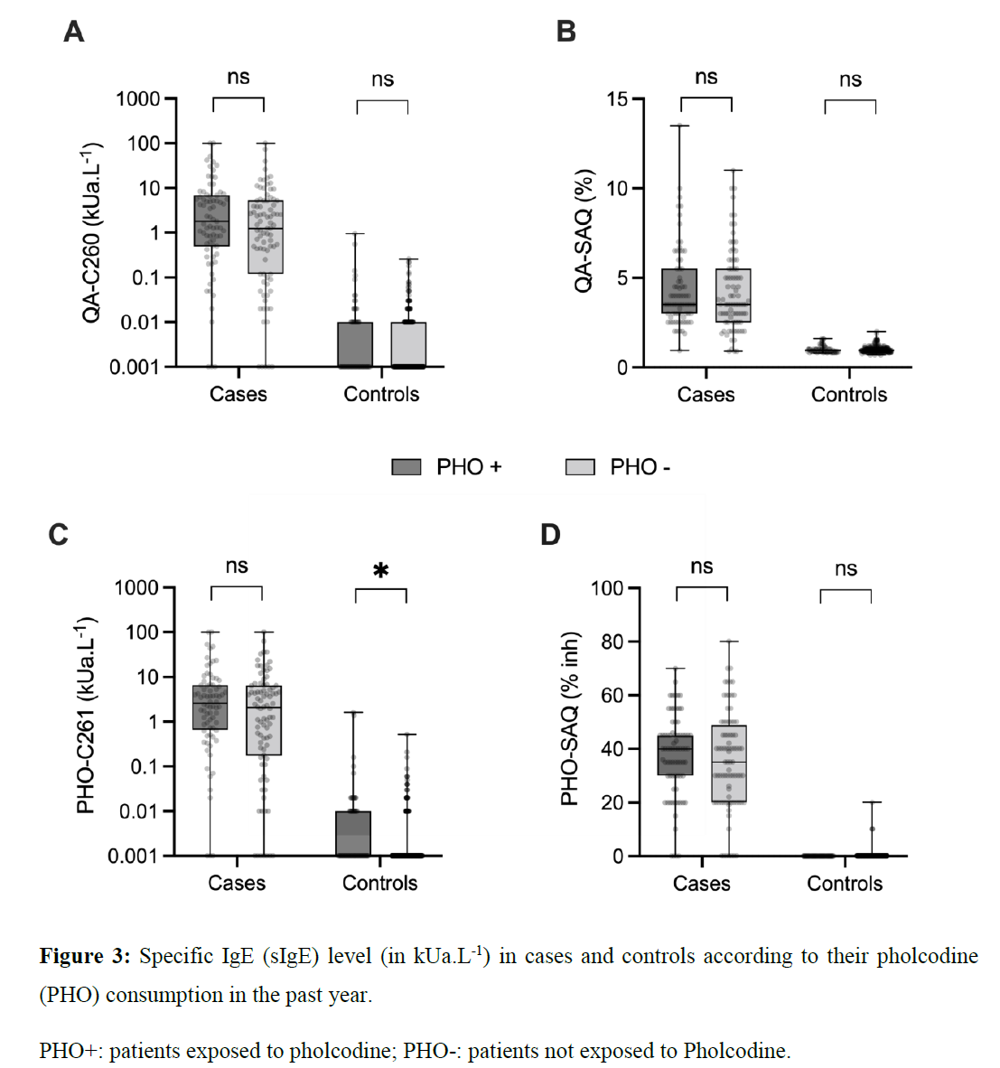
Pholcodine consumption increases the risk of perioperative anaphylaxis to neuromuscular blocking agents: the ALPHO case-control study
PHO and QA sIgEs had a high negative predictive value (99.9%) but a very low positive predictive value (< 3%) for identifying NMBA-related reactions.
The best results were obtained with the SAQ method only available in France
Mertes et al, BJA in press

Slide 19
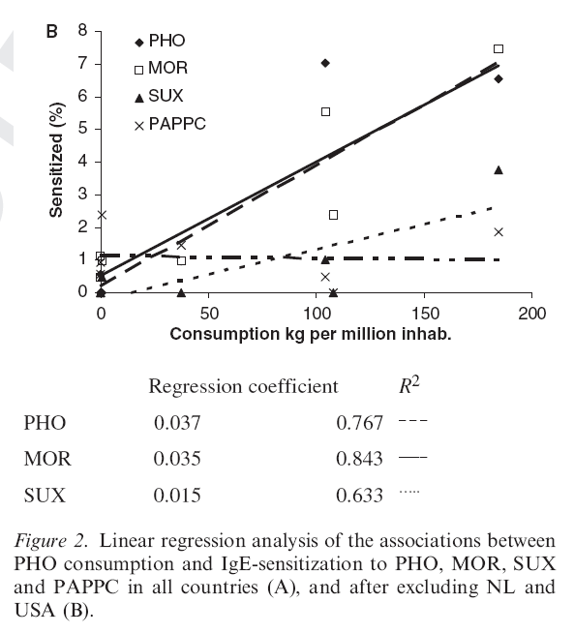
National pholcodine consumption and prevalence of IgE-sensitization: a multicentre study
Positive association between PHO consumption and prevalences of IgE to PHO and MOR, but not to SUX and PAPPC,
The Netherlands and the USA, did not have PHO-containing drugs on the markets, but had high figures of IgE-sensitization.
This international prevalence study lends additional support to the PHO hypothesis
The results also indicate that other unknown substances may lead to IgE-sensitization towards NMBAs.
Allergy 2009 DOI: 10.1111/j.1398-9995.2009.02193.x

Slide 20
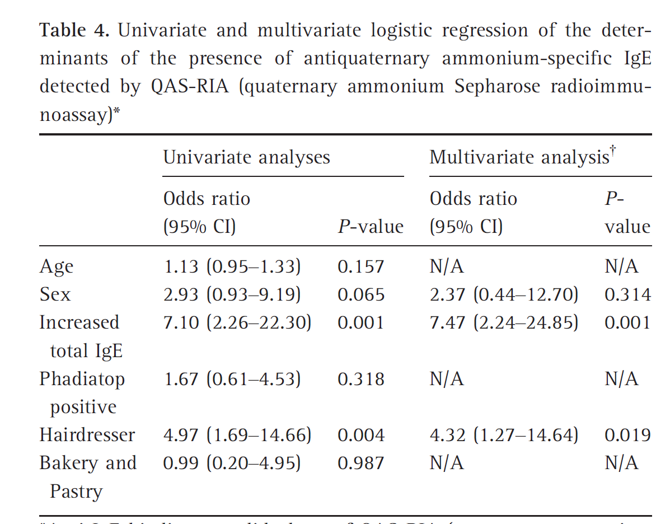
Prevalence of IgE against neuromuscular blocking agents in hairdressers and bakers.
Hairdresser populations (n = 128) were compared with baker/pastry makers (n = 108) and ‘non-exposed’ matched control subjects (n = 379).
4.6-fold higher frequency of positive IgE against quaternary ammonium ions in hairdressers
Specific IgE recognized two compounds widely used by hairdressers, benzalkonium chloride and polyquaternium-10, in competitive inhibition of IgE RIA.
Repetitive exposure to quaternary ammonium compounds used in hairdressing is a risk factor for NMBAs sensitization.
Dong S, Acouetey DS, Guéant-Rodriguez RM, Zmirou-Navier D, Rémen T, Blanca M, Mertes PM, Guéant JL. Clin Exp Allergy. 2013 Nov;43(11):1256-62.

Slide 21

And now?

Slide 22

Epidemiology

Slide 23
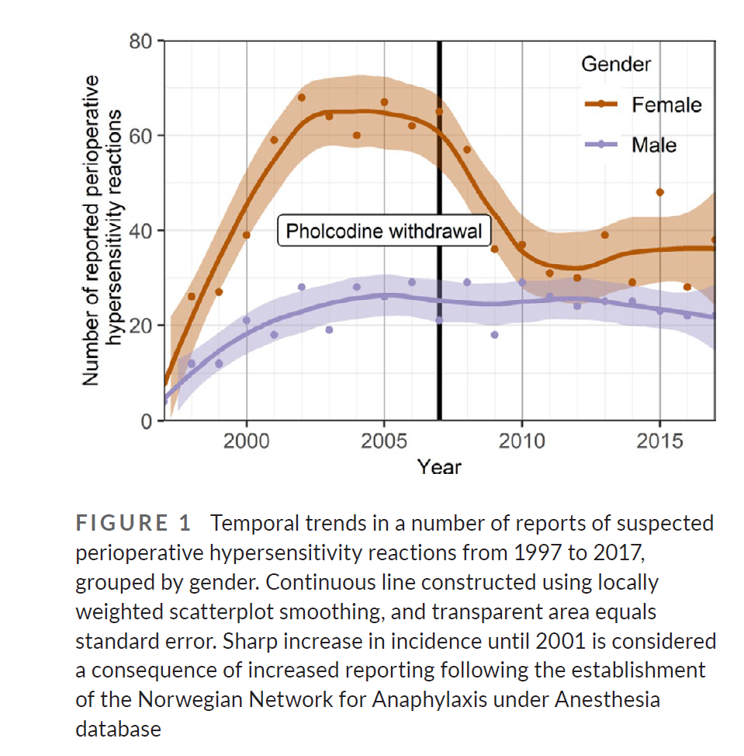
Gender-specific decline in perioperative allergic reactions in Norway after withdrawal of pholcodine
Women account for two thirds of reported cases.
After PHO withdrawal the gender difference has become less pronounced.
The reduction in reports was more pronounced in women aged 14–51
This finding could represent an interesting theme for further research ?
Malvik LB, De Pater GH, Dahle GO, Guttormsen AB. Allergy. 2022 Apr;77(4):1317-1319.

Slide 24

GERAP: the right tool to assess the impact of pholcodine withdrawal in the general population and by gender
 | 1989 | 1992 | 1994 | 1996 | 1998 | 2000 | 2002 | 2004 | 2007 | 2012 | 2018
 | n=821 | n=813 | n=1030 | n=734 | n=486 | n=518 | n=502 | n=406 | n=602 | n=489 | n=471
Curares | 81,0 | 70,2 | 59,2 | 61,6 | 69,2 | 58,2 | 54,0 | 49,6 | 48,0 | 60,6 | 60,0
Antibiotiques | 2,0 | 2,6 | 3,1 | 8,3 | 8,0 | 15,1 | 14,7 | 12,2 | 17,9 | 18,2 | 25,0
Latex | 0,5 | 12,5 | 19,0 | 16,6 | 12,1 | 16,7 | 22,3 | 26,4 | 20,3 | 5,2 | 2,0
Hypnotiques | 11,0 | 5,6 | 8,0 | 5,1 | 3,7 | 3,4 | 0,8 | 1,4 | 0,8 | 2,2 | 2,0
Opioïdes | 3,0 | 1,7 | 3,5 | 2,7 | 1,4 | 1,3 | 2,4 | 1,4 | 1,8 | 1,4 | 1,1
Colloïdes | 0,5 | 4,6 | 5,0 | 3,1 | 2,7 | 4,0 | 2,8 | 4,6 | 2,3 | 0,6 | 0,2
Autres | 2,0 | 2,8 | 8,3 | 2,6 | 2,9 | 1,3 | 3,0 | 4,4 | 7,1 | 11,8 | 9,7
Distribution (en %) des substances responsables de réactions allergiques périopératoires en France entre 1989 et 2018.
Enquêtes du GERAP

Slide 25

mechanisms

Slide 26
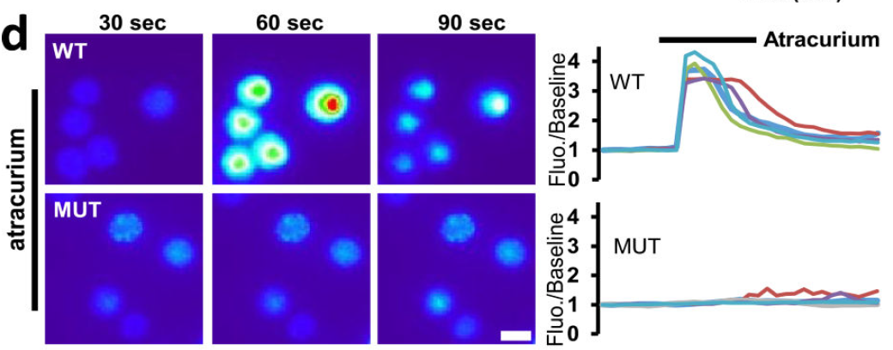
Identification of a mast cell specific receptor crucial for pseudo-allergic drug reactions
mast cells is their antibody-independent responsiveness to a range of cationic substances
all NMBD families except succinylcholine activated mast cells
Mc Neil BD et al, Nature. 2015 March 12; 519(7542): 237–241. doi:10.1038/nature14022.

Slide 27
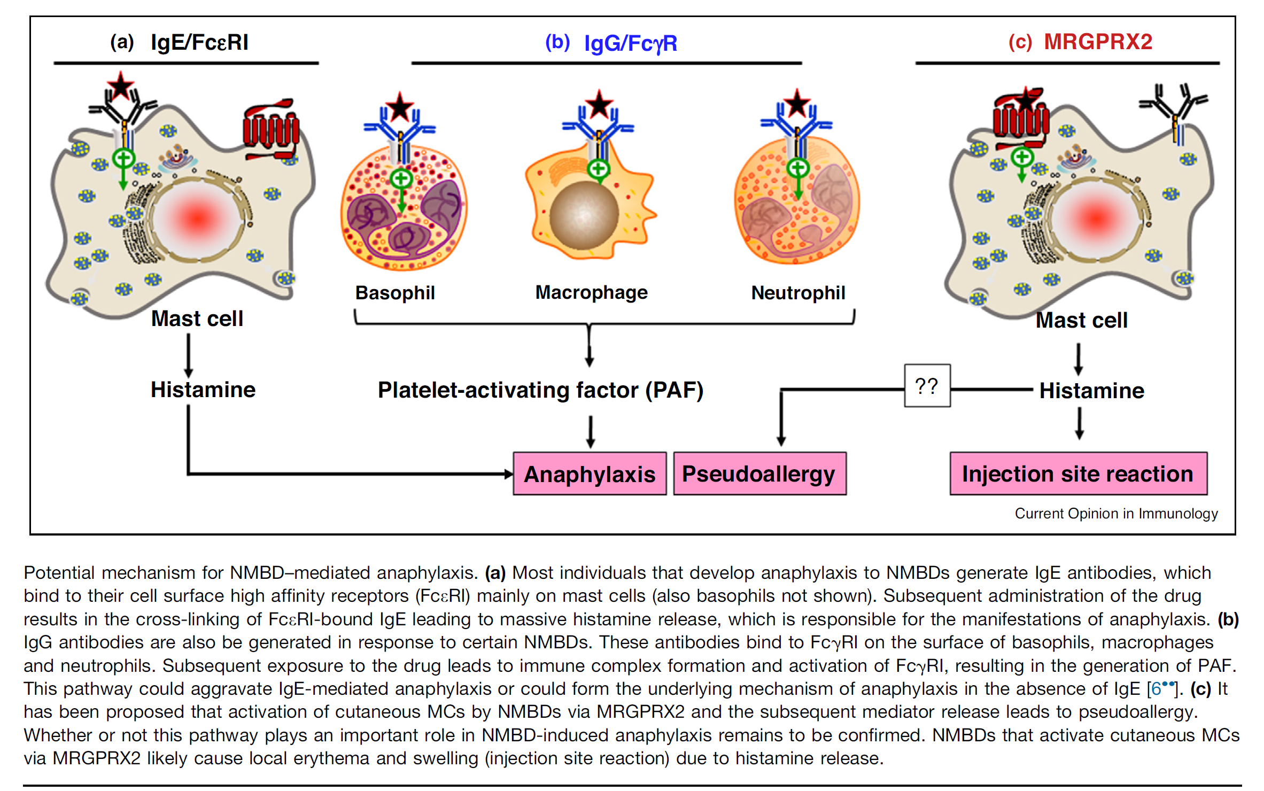
NMBAs Anaphylaxis : IgE, IgG or MGPRX2?
Current Opinion in Immunology 2021, 72:65–71

Slide 28
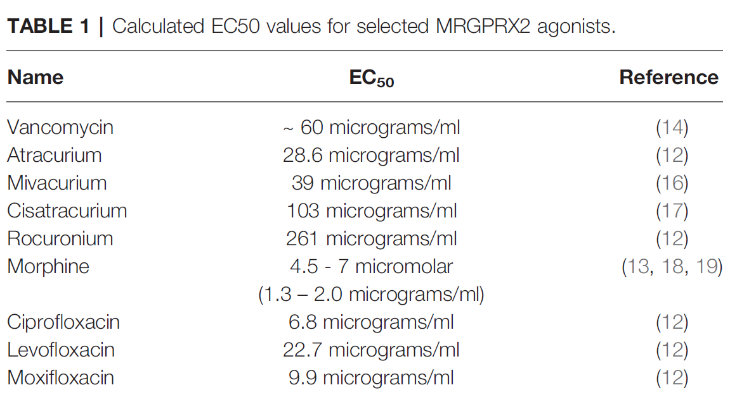
MRGPRX2 - EC50 values vs peak plasma concentrations
Peak Plasma Concentrations
Atracurium : < 10 microgram/ml
Mivacurium : 3-10 micrograms/ml
Cis-Atracurium: < 2 micrograms/ml
Rocuronium : 6-15 micrograms/ml
Succinylcholine : not acting on MRGPRX2
McNeil BD (2021) MRGPRX2 and Adverse Drug Reactions. Front. Immunol. 12:676354. doi: 10.3389/fimmu.2021.676354
28

Slide 29
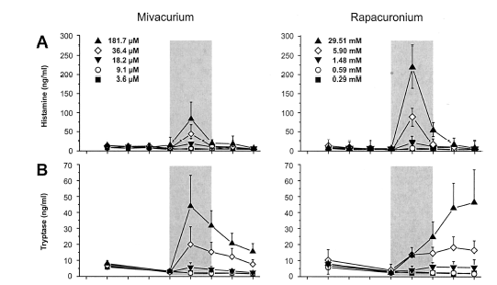
Different Patterns of Mast Cell Activation by NMBAs in Human Skin
succinylcholine and isoquinolines dose–response curves paralleled the histamine and tryptase release.
Aminosteroids evoked a rapid histamine release and a delayed increase in tryptase.
The different pattern of tryptase release by isoquinolines and aminosteroids suggests different mechanisms of mast cell activation.
Koppert et al, Anesthesiology 2001; 95:659–67

Slide 30
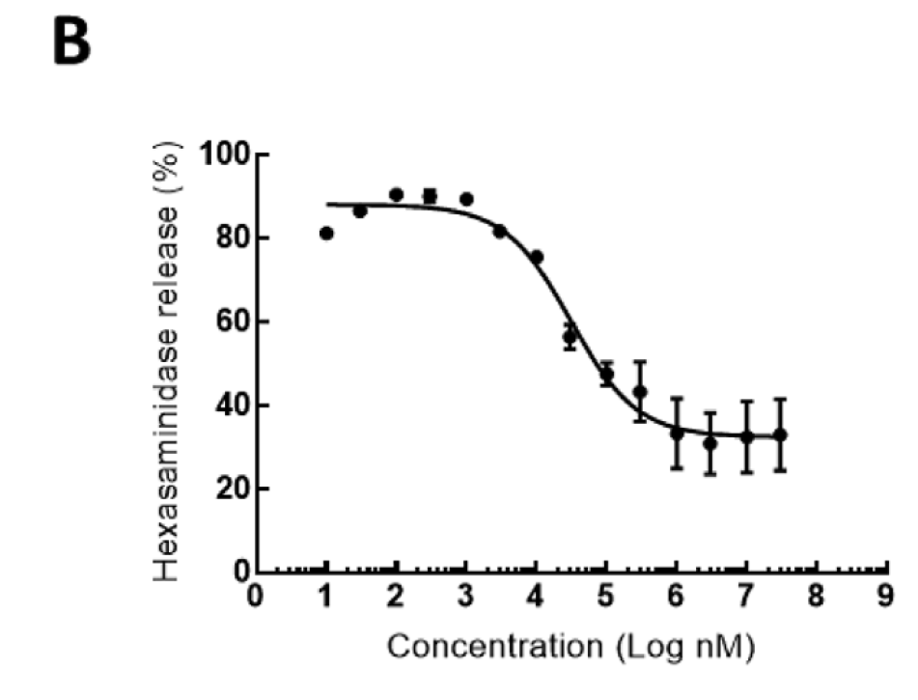
Designing new assays ?
A novel MRGPRX2-targeting antagonistic DNA aptamer inhibits histamine
release and prevents mast cell-mediated anaphylaxis
Aptamers are short sequences of artificial DNA, RNA or peptide that bind a specific target molecules
Aptamer-X35 titration curve in compound 48/80- treated MRGPRX2-RBL-2H3 cells. Hexosaminidase was used as a marker of exocytosis.
Suzuki Y, et al, Eur J Pharmacol. 2020 Jul 5;878:173104.

Slide 31
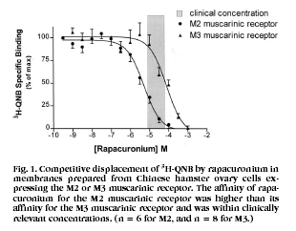
A Mechanism for Rapacuronium-induced Bronchospasm
M2 Muscarinic Receptor Antagonism
Rapacuronium has a higher affinity for M2 muscarinic receptors as compared with M3 muscarinic receptors.
Blockade of M2 muscarinic receptors on prejunctional parasympathetic nerves
➔ increased release of acetylcholine
➔ M3 muscarinic receptor–mediated airway smooth muscle constriction
Jooste et al. Anesthesiology 2003; 98:906–11

Slide 32

Can We Identify Other Potential Sensitizers?

Slide 33
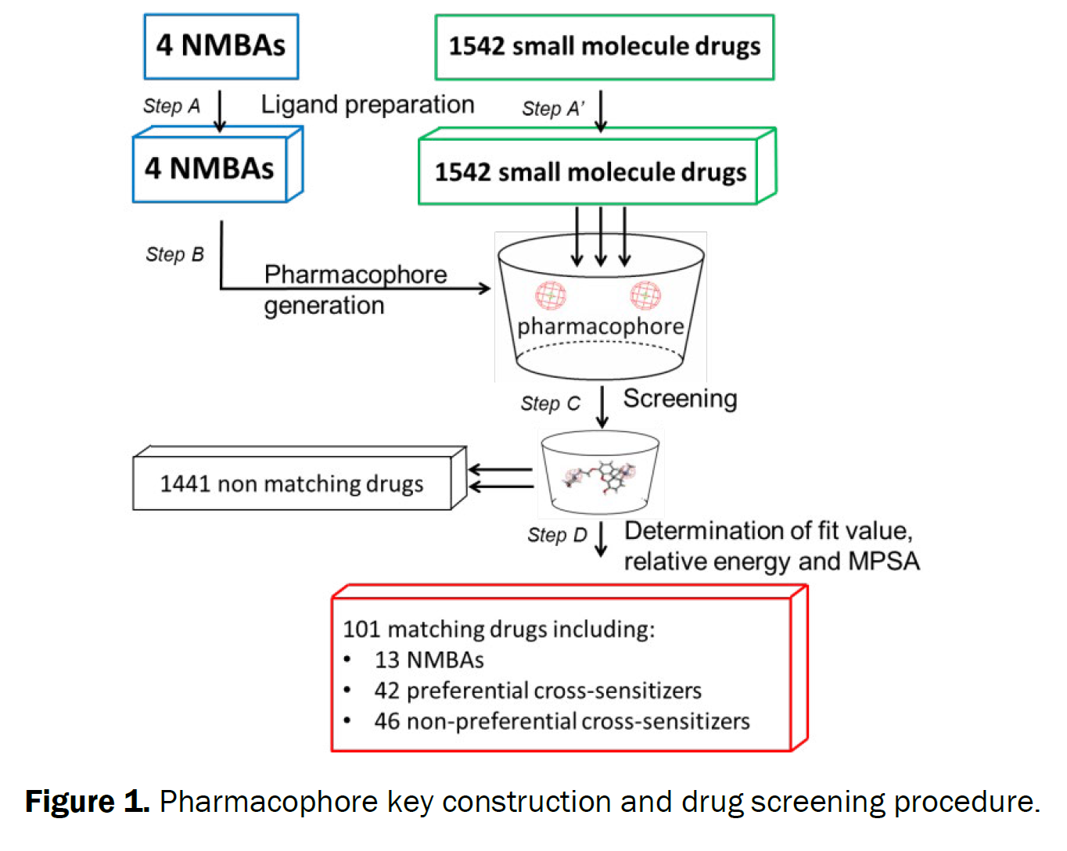
A Modeling Approach towards Identifying Potential Bivalent Sensitizers of Neuromuscular Blocking Agents
We constructed a pharmacophore key from chemical features common to all NMBAs (two positive or ionizable features 1.0807 nm apart)
We screen FDA-approved small drug molecules of the Drug Bank® database (1541 molecules).
The selected molecules were categorized on the basis of the values for three main parameters (fit value, relative energy and mean polar surface area).
Marc Pudlo1*, Lucie Javot2, Paul Michel Mertes3, Philippe Trechot4, Pierre Gillet4 and Nadine Petitpain2
Research and Reviews: Journal of Pharmacy and Pharmaceutical Sciences 2016

Slide 34
A Modeling Approach towards Identifying Potential Bivalent Sensitizers of Neuromuscular Blocking Agents
Screening from the pharmacophore key selected 13 NMBAs and 88 non-NMBA drugs.
42 had high-ranking parameter values and were considered preferential cross-sensitizers.
These included the dopamine D2 receptor ligands, aripiprazole, domperidone, Pholcodine, nizatidine, ranitidine, antrafenine, cabergoline, chlorhexidine
Pharmacophore modelling is an inexpensive, straightforward approach that can be used to identify potential NMBA cross-sensitizing agents.
Pholcodine fit within the pharmacophore key: positive ionizable features or charges (red sphere) pholcodine presented as sticks with carbon (grey), hydrogen (white), oxygen (red) and nitrogen (blue).
Marc Pudlo1*, Lucie Javot2, Paul Michel Mertes3, Philippe Trechot4, Pierre Gillet4 and Nadine Petitpain2
Research and Reviews: Journal of Pharmacy and Pharmaceutical Sciences 2016

Slide 35

How can we improve our pharmacophore?

Slide 36
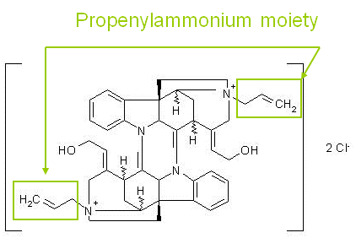
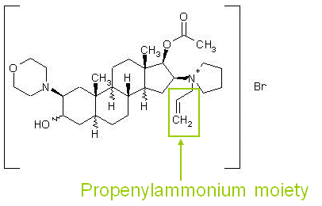
Alcuronium - Rocuronium
The propenylammonium moieties of alcuronium are chemically unrelated to the substituted ammonium or amine groups on the other NMBAs but it also occurs on rocuronium.
As for alcuronium in the late 1970s, rocuronium has been claimed to be at high risk for anaphylaxis. If this is true, propenylammonium moieties present in both NMBAs may account for the apparent increased allergenicity.

Slide 37
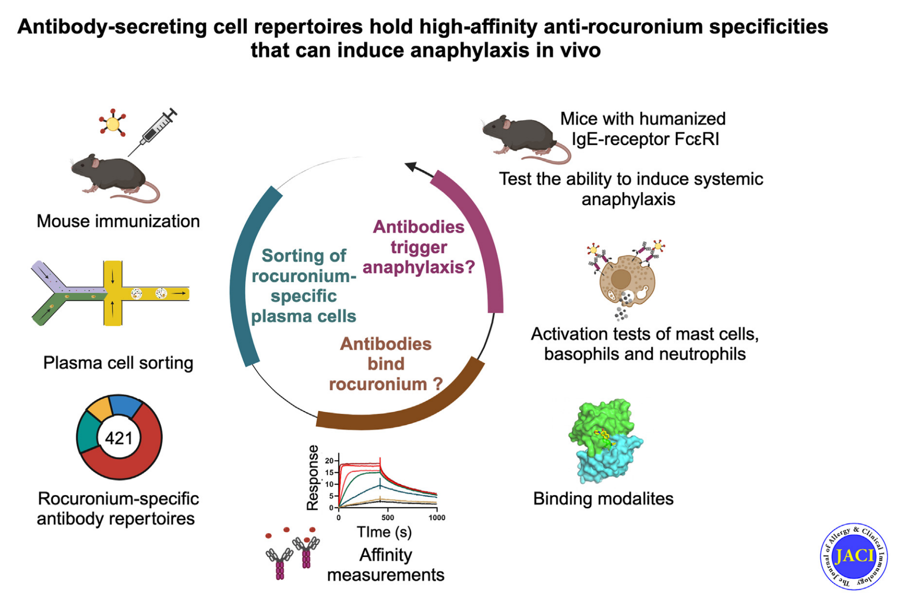
Antibody-secreting cell repertoires hold high-affinity anti-rocuronium specificities that can induce anaphylaxis in vivo
immunizing mice with neuromuscular blocking agent rocuronium enabled identification from IgG secreting cells of rocuronium-specific high-affinity antibodies. Expressed as human IgE, these antibodies trigger mast cell and basophil activation as well as systemic anaphylaxis in mouse models.
Dejoux A, Zhu Q, Woolfe A, Godon O, Ellouze S, Mottet G, Castrillon C, Gillis C, Pecalvel C, Ganneau C, Iannascoli B, Lemoine F, Saul F, England P, Reber LL, Gouel-Chéron A, de Chaisemartin L, Haouz A, Millot GA, Bay S, Gérard A,
Jönsson F, Chollet-Martin S, Bruhns P. Antibody-secreting cell repertoires hold high-affinity anti-rocuronium specificities that can induce anaphylaxis in vivo. J Allergy Clin Immunol. 2025 Jan 30:S0091-6749(25)00113-7.

Slide 38
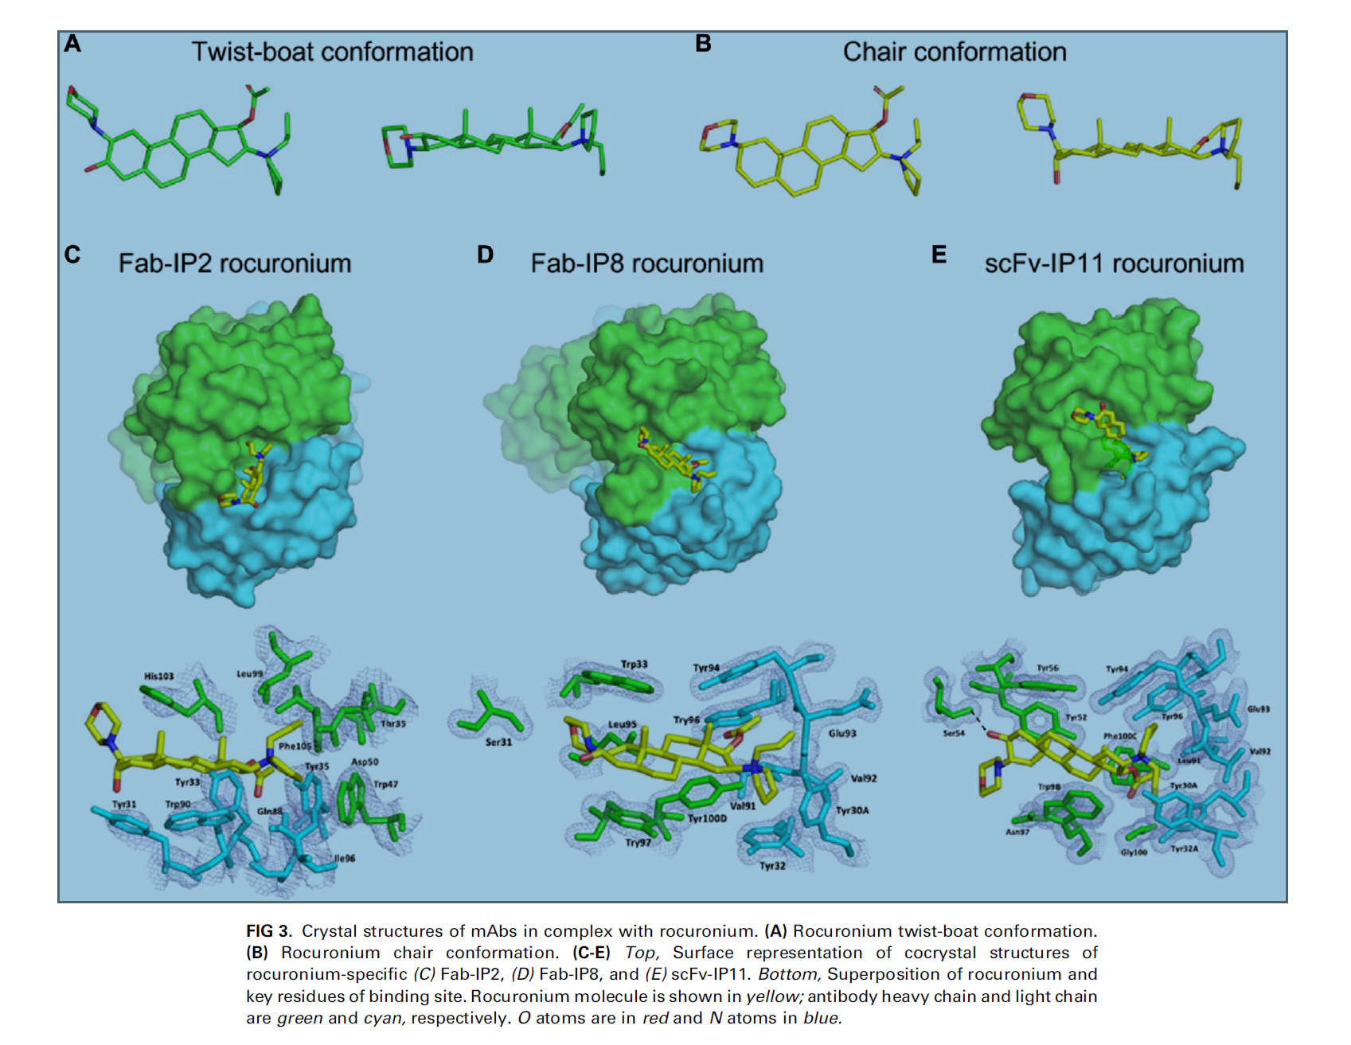
Antibody-secreting cell repertoires hold high-affinity anti-rocuronium specificities that can induce anaphylaxis in vivo
Cocrystal structures between rocuronium and antibody representatives of 3 different VH-VL families revealed distinct interaction modes, with the ammonium group involved systematically in the binding interface.
Dejoux A, Zhu Q, Woolfe A, Godon O, Ellouze S, Mottet G, Castrillon C, Gillis C, Pecalvel C, Ganneau C, Iannascoli B, Lemoine F, Saul F, England P, Reber LL, Gouel-Chéron A, de Chaisemartin L, Haouz A, Millot GA, Bay S, Gérard A,
Jönsson F, Chollet-Martin S, Bruhns P. Antibody-secreting cell repertoires hold high-affinity anti-rocuronium specificities that can induce anaphylaxis in vivo. J Allergy Clin Immunol. 2025 Jan 30:S0091-6749(25)00113-7.

Slide 39

creating new functional tests ?

Slide 40
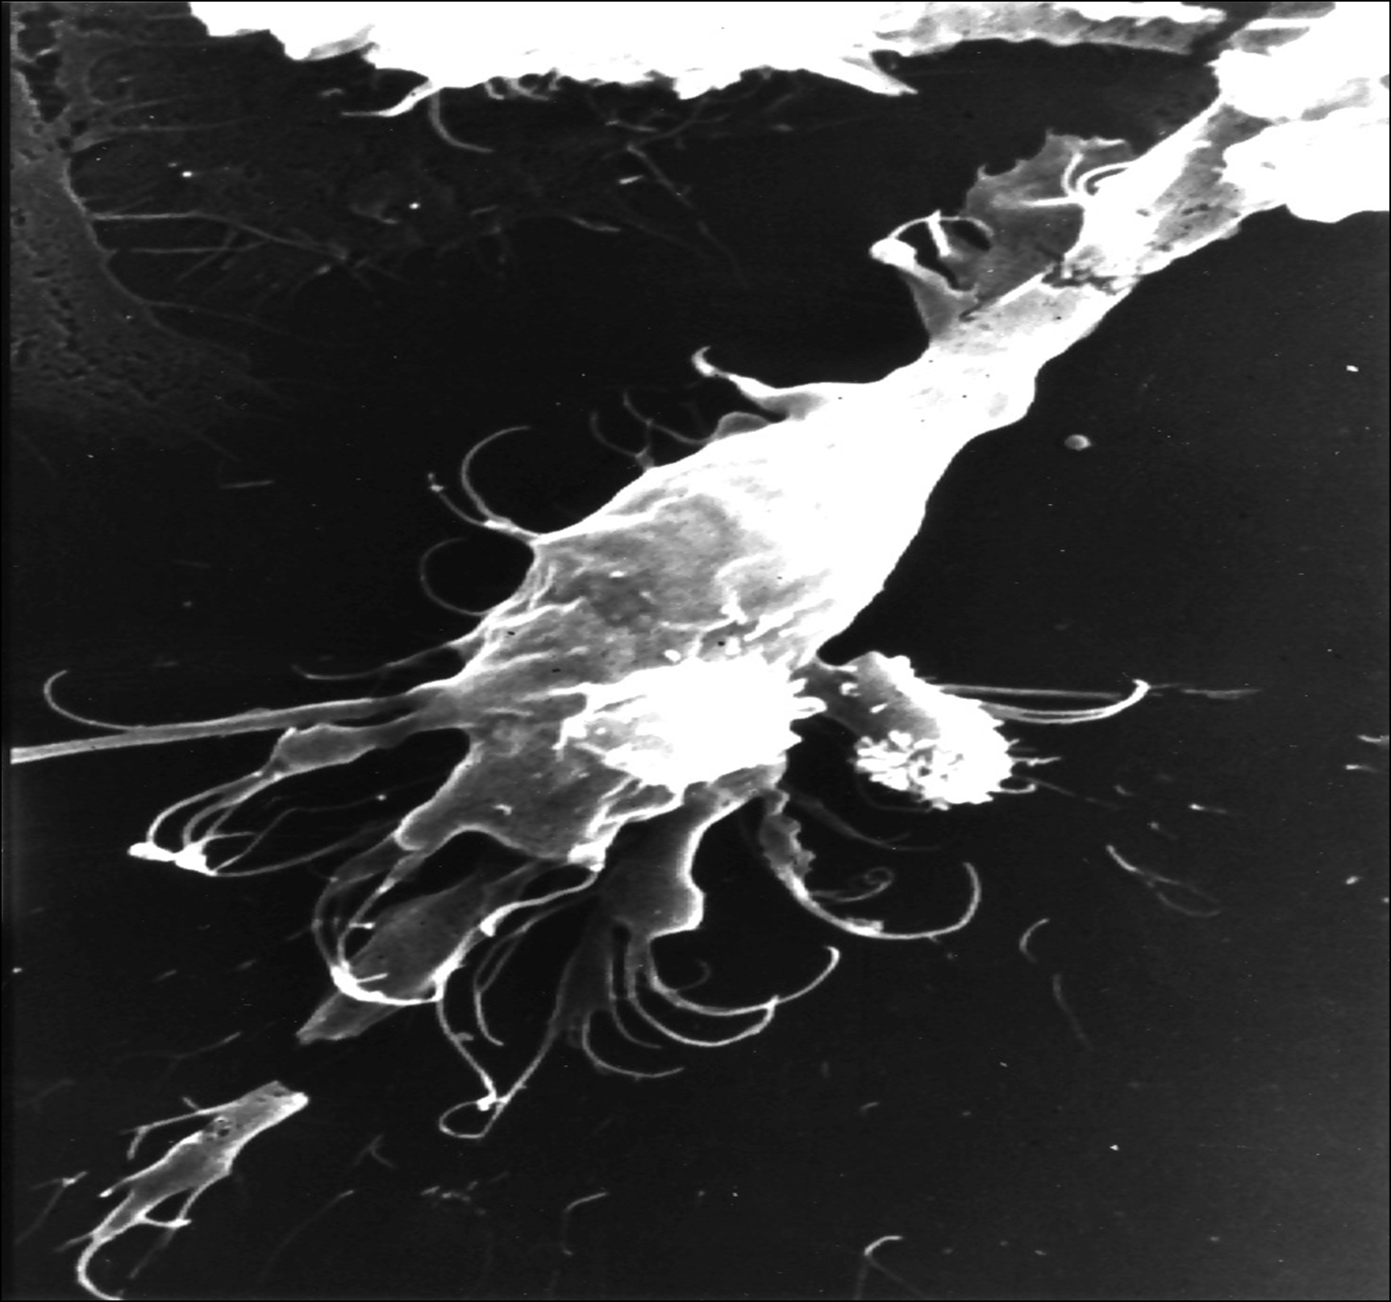
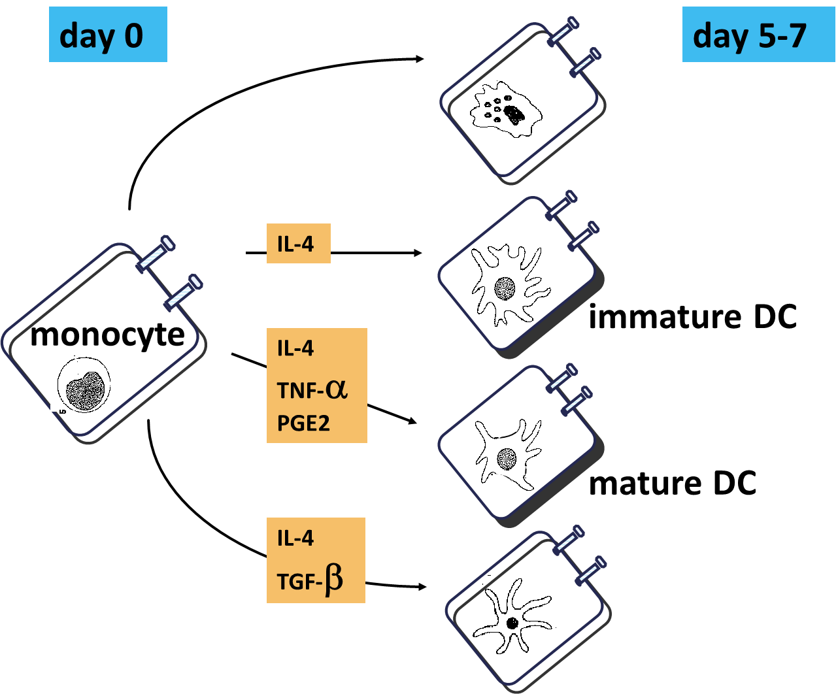
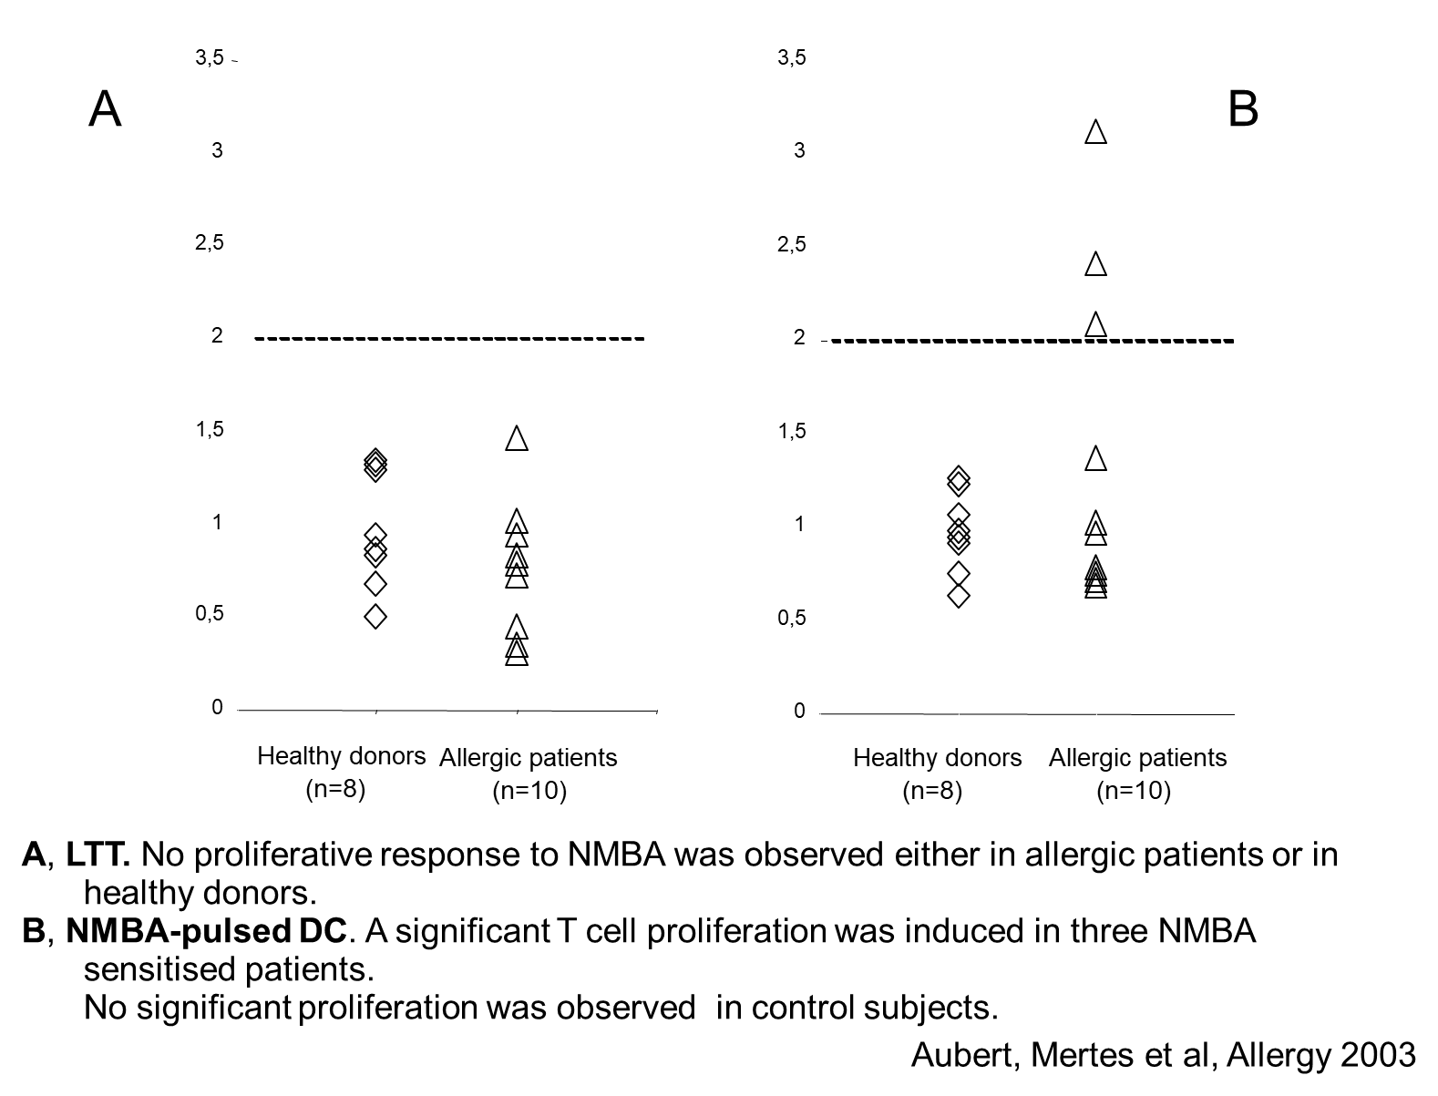
Dendritic Cells and NMBA Ag Presentation to Lymphocytes
Aubert N, Mertes PM, Janaszak M, Moneret-Vautrin DA, Laxenaire MC, Kanny G, Lavaud F, Bernard J. Dendritic cells present neuromuscular blocking agent-related epitopes to T cells from allergic patients. Allergy. 2004 Sep;59(9):1022-3.

Slide 41
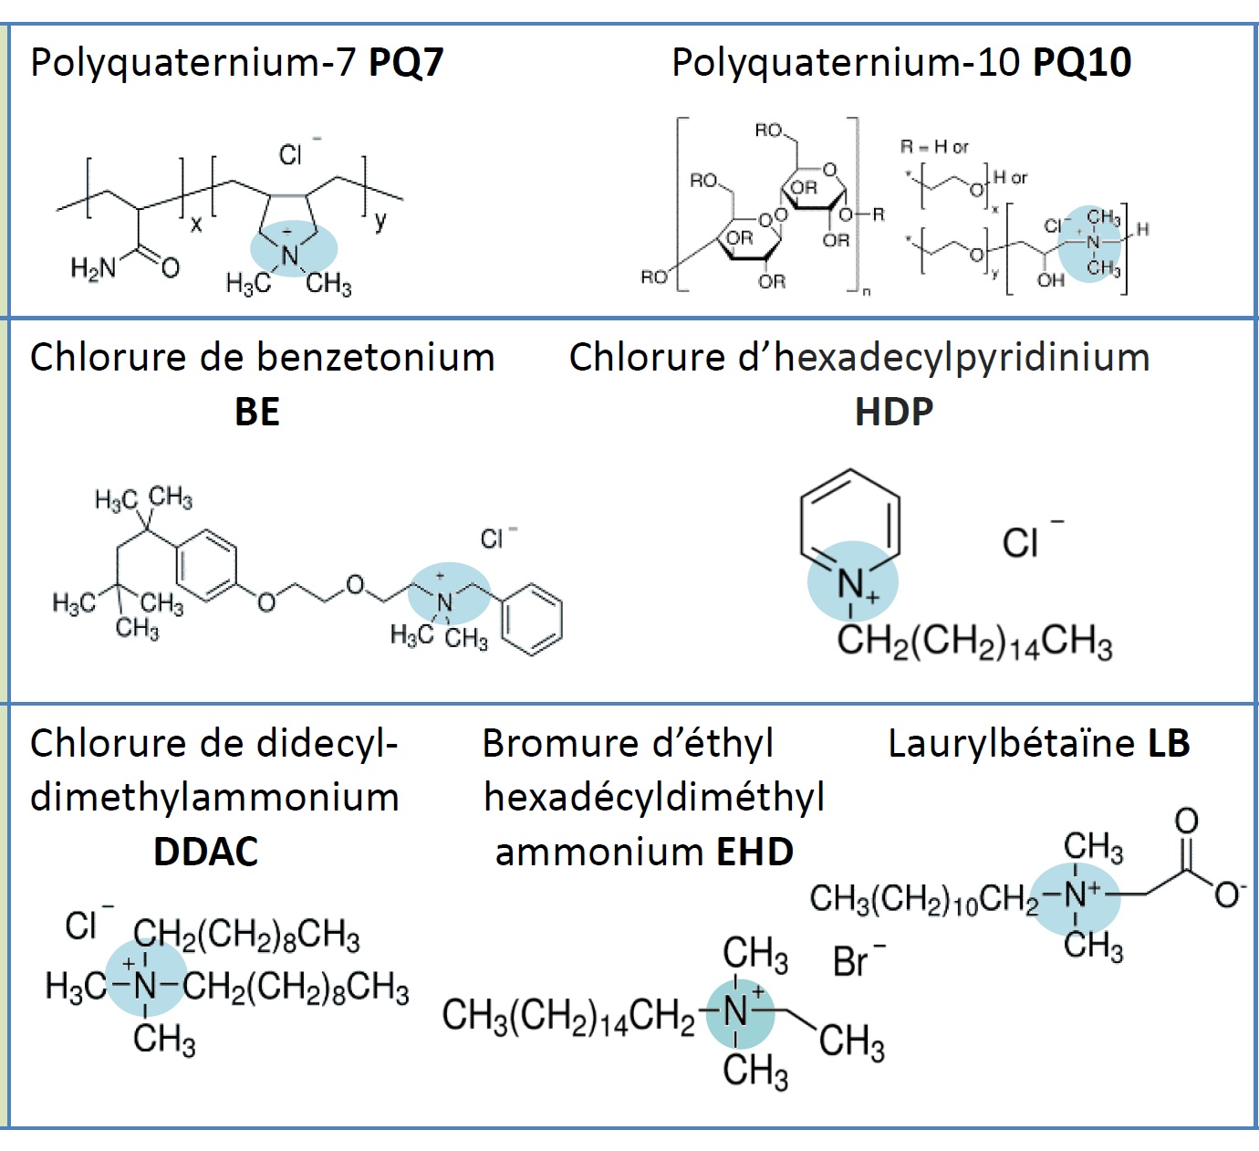
Quaternary ammoniums activate human dendritic cells and induce a specific T-cell response in vitro Peyneau M et al, Allergol Int. 2025 Jan;74(1):105-114.
Evaluation of sensitization capacity of seven QACs (two polyquaterniums, three alkylammoniums and two aromatic ammoniums) using two standard dendritic cells (DCs) models
Allergenicity investigation of the sensitizing compounds using T-cell-DC co-culture models.
  Polymeric : shampoo, shower gel
  Cyclic and aromatic : surfactant, antimicrobial agents, conservatives
  Aliphatic: surfactant, antimicrobial agents, conservatives

Slide 42
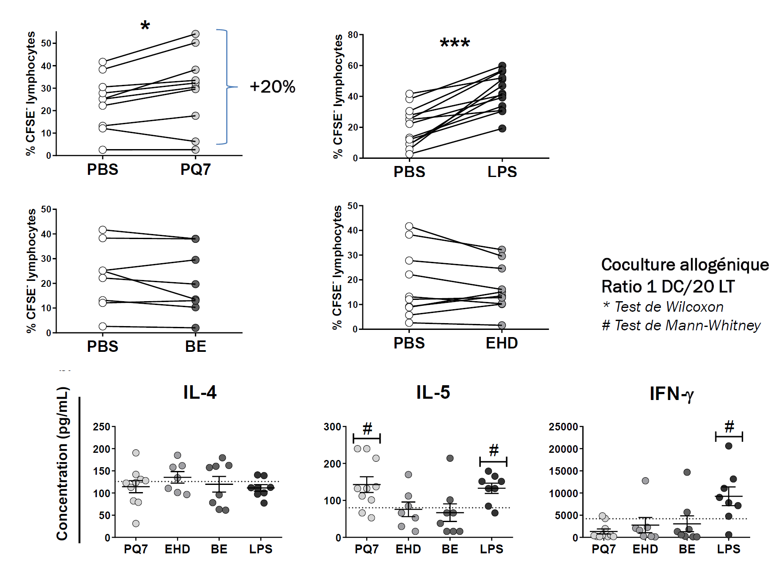
PQ7 :
presented by monocytes derived dendritic cells
recognized by a T Lymphocyte Repertoire
Peyneau et al,

Slide 43
Conclusion
The withdrawal of pholcodine: a hope for reducing the incidence of anaphylaxis to NMBAs.
Epidemiological data are mandatory to confirm this reduction and explore the impact according to patient characteristics.
New tools are necessary to improve our understanding of the mechanisms of these reactions.
The search for new molecules that could induce cross-sensitization is possible.
Data concerning NMBA-antibody interactions may potentially allow the development of NMBAs with an improved safety profile.

Slide 44

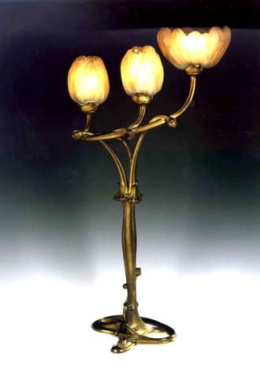
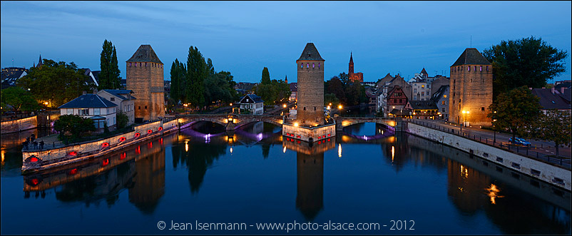
Thank you for your attention

